Slide 1

WELCOME TO
CLOUDHOUR
CloudHour will be starting shortly...
Please feel free to grab a drink and invite your friends!

Slide 2

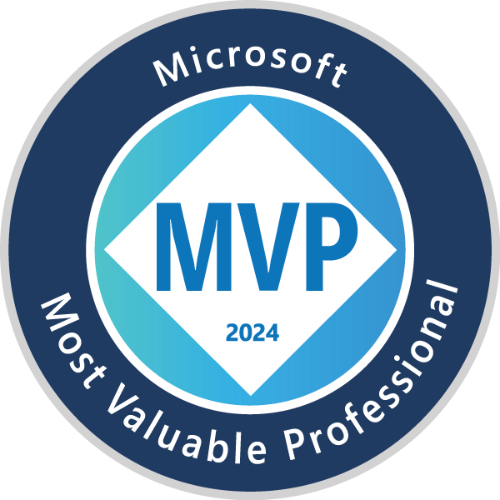
Co-host Truls Dahlsveen
Background
Sysadmin & network admin roots
6 years SOC experience
2 years pentesting
Once ranked #2 on HackTheBox Norway
Highlights
World's first Microsoft Sentinel Black Belt
Lead architect on Norway's first Microsoft MXDR-verified solution
Off the clock
Battlefield 6 enthusiast
World top 500 Mythic Sire Denathrius
Converted cat person
Owns a road bike that's never seen the outdoors
Social media
https://infernux.no/
https://www.linkedin.com/in/truls-dahlsveen/
Notes:
https://infernux.no/
https://www.linkedin.com/in/truls-dahlsveen/

Slide 3
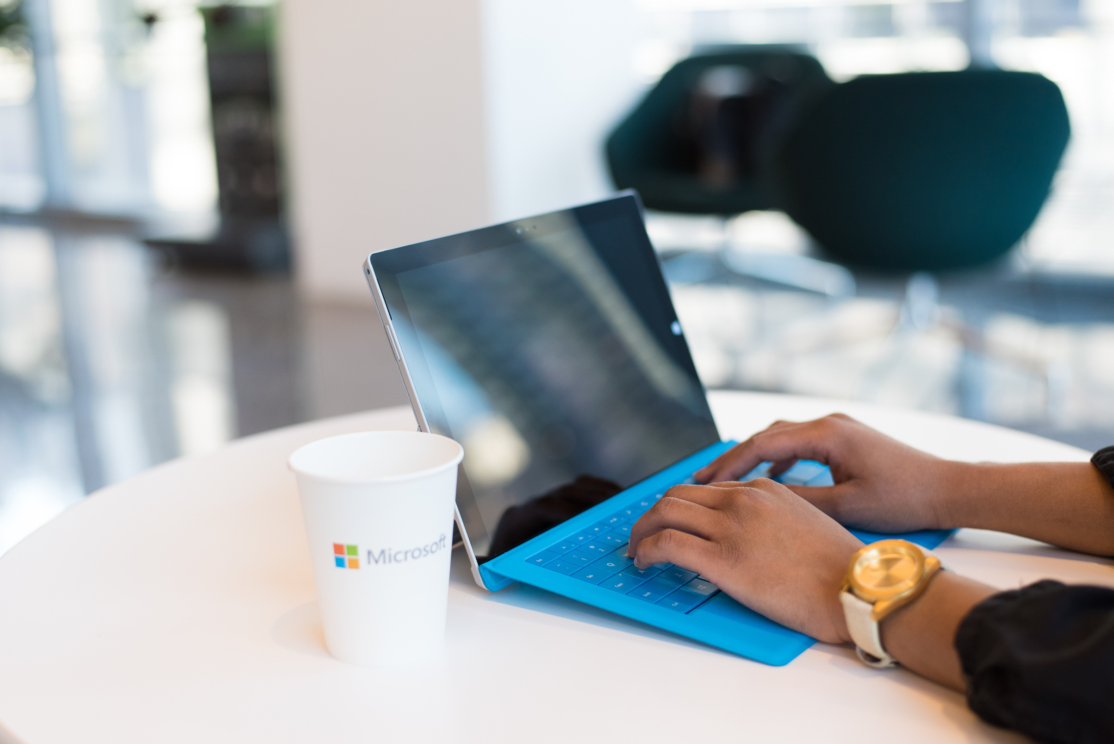
WHAT IS
CLOUD HOUR
CloudHour is a round-table discussion where we focus on a few key topics for collaborative discussion
Why it is important
Rapid changes in cloud security and tech
Stay updated and connected for growth as a community.
How will it benefit the community
Real-time engagement with hosts and community members
Ask open questions and speak your opinion
Opportunity to shape the next agenda

Slide 4

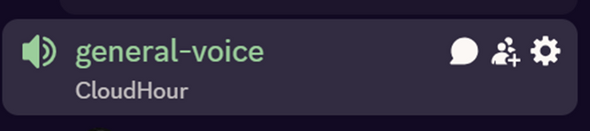
BEFORE WE
START
If you prefer not to talk or be asked questions, please press mute
Open mic is allowed
Remember to open the chat and engage with our community!

Slide 5
SHARING
Windows 365 SMB price cut [Change]
LINKS TO SHARE
Microsoft reduces Business-tier pricing; new bundles for SMB resellers.
Entra ID - Agent ID Platform
GA of the identity/authorization framework for AI agents, supporting OAuth 2.0 and MCP.
DNSSEC Enablement Wizard
for Exchange Online between June-august
Microsoft 365 E7 "Frontier Suite announced at $99/user/month,
bundling M365 E5 + Copilot + Entra Suite + Agent 365. First new Microsoft 365 SKU above E5 since 2018. Impact: ELA renegotiation trigger for enterprises already on E5+Copilot.
Passkeys on Windows (Windows Hello container) [Rollout]
Device-bound and synced FIDO2 passkeys natively in the Windows Hello container; admin policies via Intune/Entra.
Anything else you would like to share?
Notes:
Entra ID - Agent ID Platform
GA of the identity/authorization framework for AI agents, supporting OAuth 2.0 and MCP.
https://learn.microsoft.com/en-us/entra/fundamentals/whats-new
https://learn.microsoft.com/en-us/entra/agent-id/whats-new-agent-id
Microsoft 365 E7 "Frontier Suite" announced at $99/user/month,
bundling M365 E5 + Copilot + Entra Suite + Agent 365. First new Microsoft 365 SKU above E5 since 2018. Impact: ELA renegotiation trigger for enterprises already on E5+Copilot.
https://www.microsoft.com/en-us/security/blog/2026/05/01/microsoft-agent-365-now-generally-available-expands-capabilities-and-integrations/
Passkeys on Windows (Windows Hello container) [Rollout]
Device-bound and synced FIDO2 passkeys natively in the Windows Hello container; admin policies via Intune/Entra.
https://learn.microsoft.com/en-us/entra/fundamentals/whats-new#general-availability---synced-passkeys-in-microsoft-entra-id
Windows 365 SMB price cut [Change]
Microsoft reduces Business-tier pricing; new bundles for SMB resellers.
https://www.computerworld.com/article/4159190/microsoft-to-cut-windows-365-price-for-smbs.html
DNSSEC Enablement Wizard for Exchange Online between June-august
https://techcommunity.microsoft.com/blog/exchange/modernizing-dns-security-for-exchange-online-mail-flow/4514248
DNSSEC (Domain Name System Security Extensions) adds a digital signature to DNS records.
DNS is like the internet's phonebook: it turns "google.com" into an IP address. The problem is the basic phonebook has no way to prove the answer is real, so an attacker can swap in a fake one and send you to a malicious site.

Slide 6
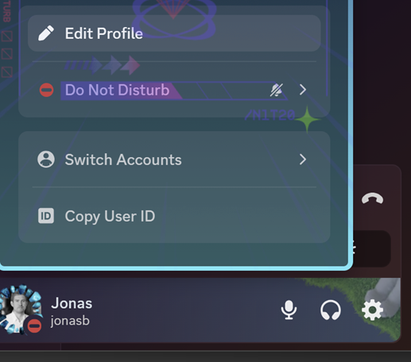
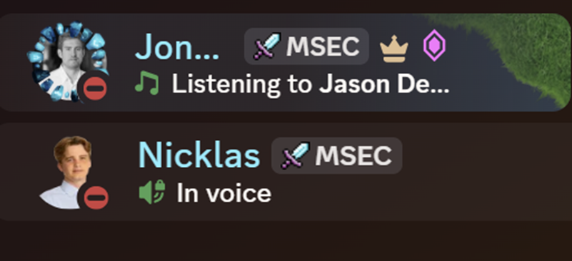
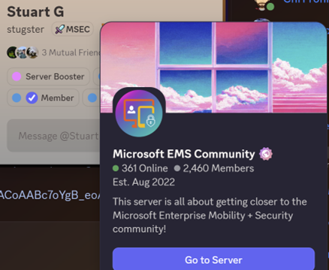
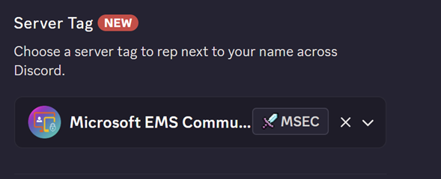
DISCORD
SERVER TAG

Slide 7

AGENDA
AADGraphActivityLogs
Microsoft Foundry and security?

Slide 8
AADGraphActivityLogs — The Missing Link Has Arrived
The blind spot is finally closed - legacy Azure AD Graph API (graph.windows.net) had no logging until now; defenders were blind for years
MicrosoftGraphActivityLogs (2023) only fixed half the problem - modern Graph was logged, legacy Graph wasn't → attackers simply chose the unmonitored one
Why attackers loved the legacy API — tools like AADInternals and ROADtools (ROADrecon) operated invisibly against it
Enable it in 30 seconds — Entra ID → Diagnostic Settings → check the AADGraphActivityLogs box → send to Log Analytics
Released ~May 2026, after roughly a year of an empty table sitting in tenants
Bottom line: Microsoft may keep legacy Graph alive for years but it's no longer a safe haven
Notes:
"For years, attackers have had an asymmetric advantage - they could see us, we couldn't see them. That just changed.“
https://learn.microsoft.com/en-us/azure/azure-monitor/reference/tables/AADGraphActivityLogs

Slide 9
What's in the Table
Schema mirrors MicrosoftGraphActivityLogs - with quirks (e.g. CallerIpAddress here vs IpAddress there)
Top fields for detection:
RequestUri - exact legacy endpoint hit (/users, /groups, /devices)
UserAgent - catches toolkits like ROADrecon (Python/3.12 aiohttp/...)
CallerIpAddress - real IP for user-delegated calls
AppId / ServicePrincipalId / UserId - who made the request
ActorType - quick filter: User vs Application
Two correlation goldmines:
SignInActivityId → pivots to SigninLogs.UniqueTokenIdentifier (mind the == padding!)
SessionId → ties activity across SigninLogs, MicrosoftGraphActivityLogs, and Unified Audit Log
Classified as Audit + Security category, supports Basic logs and ingestion-time DCRs
Detection example: ROADrecon fired 2,648 requests in 14.5 seconds - trivially spotted via UserAgent + endpoint fingerprint
Notes:
Microsoft Learn - AADGraphActivityLogs table reference https://www.invictus-ir.com/news/the-missing-link-aadgraphactivitylogs-finally-arrives

Slide 10
Microsoft Foundry (brand new subject im curios about)
Rebranded January 2026. Was "Azure AI Foundry", now "Microsoft Foundry". Second rename in 12 months. "Azure" dropped to signal agents are first-class citizens, not just another Azure service
One platform, three jobs: build, deploy, and govern AI apps and agents in a unified portal for devs and security teams alike 11,000+ models in the catalog. OpenAI, Anthropic (Claude Opus 4.6), xAI Grok, Mistral, Phi, NVIDIA Nemotron, plus open-source. Pick, benchmark, swap
Foundry Agent Service (GA). Production agent runtime with end-to-end private networking, MCP/OAuth passthrough, and hosted agents
Agent frameworks supported natively: Microsoft Agent Framework, LangChain, CrewAI, LlamaIndex
Foundry IQ grounds agents in your data via Azure AI Search, with built-in user access permissions honored
Why it matters for us: every "AI feature" your customers are about to ship will likely run here, and that means it lands inside your security perimeter
Notes:
Microsoft Learn - AADGraphActivityLogs table reference https://www.invictus-ir.com/news/the-missing-link-aadgraphactivitylogs-finally-arrives

Slide 11
Securing Foundry
Identity: Entra ID for RBAC across models, agents, tools, and data
Network: Private Link, Managed Network Isolation, and NSGs keep traffic off the public internet
Defender for Cloud: detects jailbreaks and prompt-injection attacks at runtime
Purview + DSPM for AI: visibility into what prompts and responses contain
Guardrails: content filtering, abuse monitoring, and Task Adherence to block off-task tool calls
Data: prompts and completions are not stored and not used to train models
Notes:
Manage compliance and security in Microsoft Foundry (Microsoft Learn, March 2026) https://learn.microsoft.com/en-us/azure/foundry/control-plane/how-to-manage-compliance-security Covers: Defender for Cloud threat protection for Foundry Tools, Purview integration, DSPM for AI, guardrail policies
Azure security baseline for Microsoft Foundry (Microsoft Learn, March 2026) https://learn.microsoft.com/en-us/security/benchmark/azure/baselines/azure-ai-foundry-security-baseline Covers: Private Link, Managed Network Isolation, NSGs, Entra ID RBAC
Data, privacy, and security for Azure Direct Models in Microsoft Foundry (Microsoft Learn, February 2026) https://learn.microsoft.com/en-us/azure/foundry/responsible-ai/openai/data-privacy Covers: stateless models, prompts/completions not stored, not used to train base models, geography processing
What's new in Microsoft Foundry, March 2026 (Microsoft Foundry Blog) https://devblogs.microsoft.com/foundry/whats-new-in-microsoft-foundry-mar-2026/ Covers: Task Adherence as native guardrail, intervention points on tool invocations and responses, third-party guardrails (Prisma AIRS, Zenity) GA
Microsoft Foundry product page (Azure) https://azure.microsoft.com/en-us/products/ai-foundry Covers: Defender + Entra ID integration in the Foundry Control Plane, runtime threat detection

Slide 12

Topic from the crowd

Slide 13
THANK YOU FOR JOINING
CLOUDHOUR
We hope that you found this session useful!
Please don’t forget to share our community with your friends and colleagues, and we look forward to seeing you next month!

